Slide 1
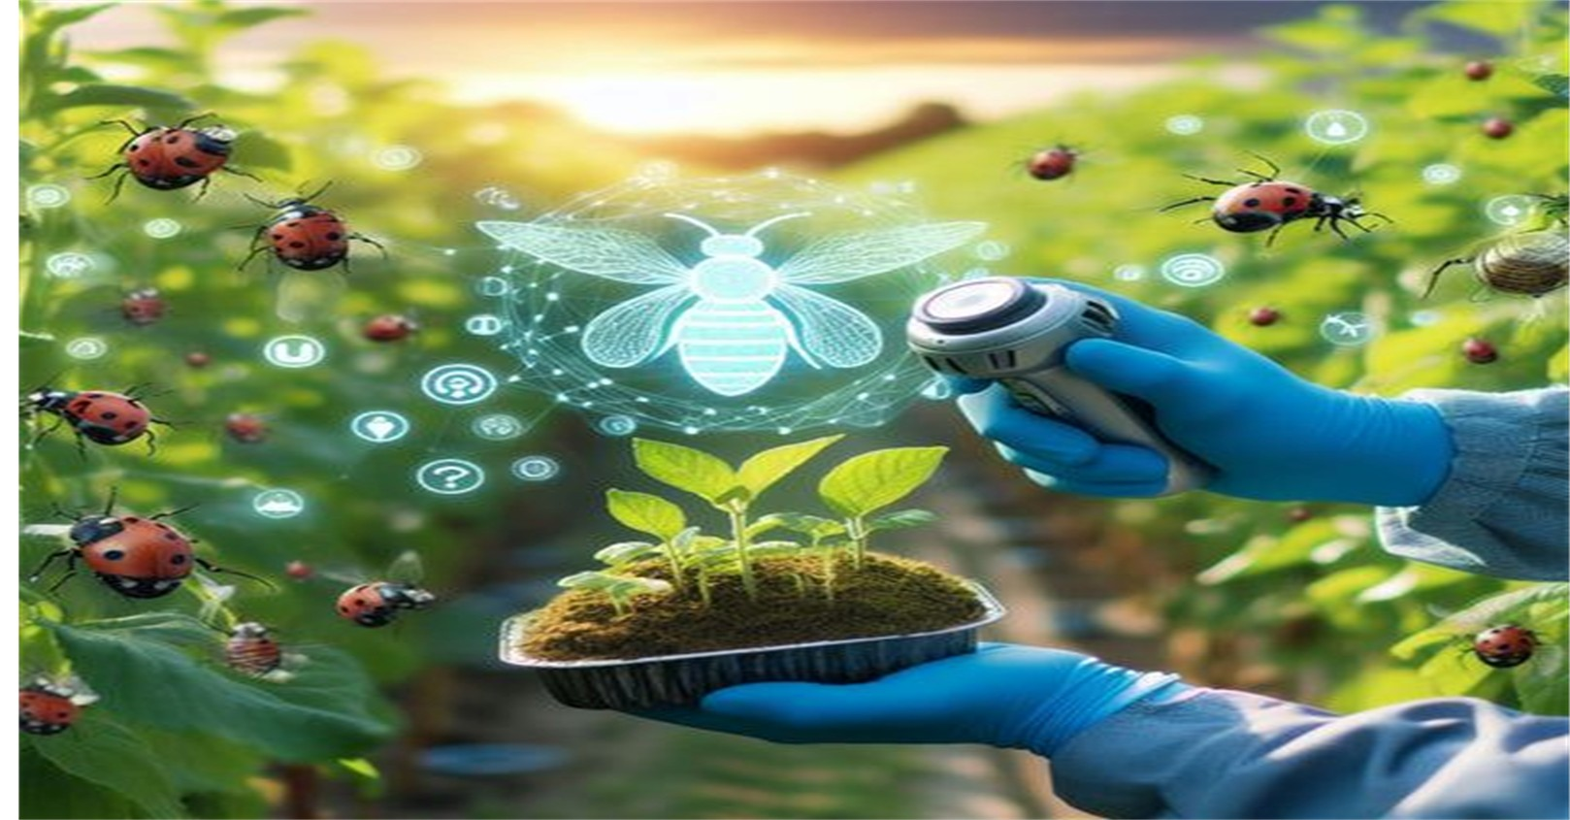
Title slide.
Farm Smartly
Don’t work hard but work smartly—or do both.
The Coders

Slide 2
Slide 1
Tips and Tricks
Website
Can be accessed by all
In Hopes to have an impact on those who need it
Information
Provides information and tips.

Slide 3
Slide 2
AI Chatbot to assist those in need.
02
01
03
Recommendations for those looking for more than tips.
Both online and offline modes meaning you can use it whether you have data or not.
04
A guide with many options and tips.

Slide 4
Slide 3
Overlap with air pollution, where outdoor and indoor air pollution in Soshanguve already worsen respiratory outcomes in children
Acute poisoning, especially from organophosphates sold informally (“street pesticides”), sometimes leading to hospitalization or even child fatalities
Water Contamination
Pesticides can seep into groundwater or run off into rivers during rain.
Chronic effects, including asthma, respiratory disease, cancers, reproductive harm, neurodevelopment disorders and endocrine disruption—even from low‑level, long‑term exposure .
Food Contamination
If vegetables and fruits are not properly washed, pesticide residues remain on the food.
Environmental drift, water contamination, and polluted soils impacting entire neighbourhoods—not just applicators .
Soil Degradation
Overuse of pesticides kills not only pests

Slide 5




Slide 5
Tips & Tricks
1.
Use Disease resistance seeds.
2. Apply safe organic chemical Pesticides
3.Practice Crop Rotation and Intercroppin
4.Inspect Crops everyweek.

